Slide 1
Vector Semantics

Slide 2
Why vector models of meaning? computing the similarity between words
“fast” is similar to “rapid”
“tall” is similar to “height”
Question answering:
Q: “How tall is Mt. Everest?” Candidate A: “The official height of Mount Everest is 29029 feet”

Slide 3
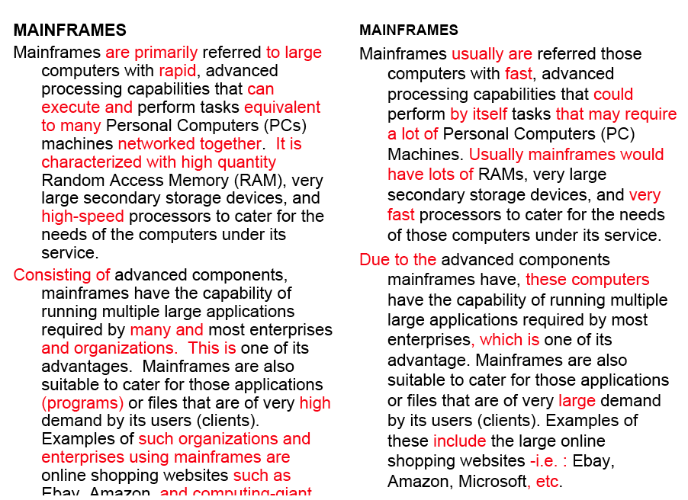
Word similarity for plagiarism detection

Slide 4
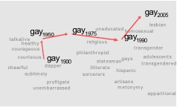
Word similarity for historical linguistics: semantic change over time
Sagi, Kaufmann Clark 2013
Kulkarni, Al-Rfou, Perozzi, Skiena 2015
4

Slide 5
Distributional models of meaning = vector-space models of meaning = vector semantics
Intuitions: Zellig Harris (1954):
“oculist and eye-doctor … occur in almost the same environments”
“If A and B have almost identical environments we say that they are synonyms.”
Firth (1957):
“You shall know a word by the company it keeps!”

Slide 6
Intuition of distributional word similarity
Nida example:
A bottle of tesgüino is on the table
Everybody likes tesgüino
Tesgüino makes you drunk
We make tesgüino out of corn.
From context words humans can guess tesgüino means
an alcoholic beverage like beer
Intuition for algorithm:
Two words are similar if they have similar word contexts.

Slide 7
Four kinds of vector models
Sparse vector representations
Mutual-information weighted word co-occurrence matrices
Dense vector representations:
Singular value decomposition (and Latent Semantic Analysis)
Neural-network-inspired models (skip-grams, CBOW)
Brown clusters

Slide 8
Shared intuition
Model the meaning of a word by “embedding” in a vector space.
The meaning of a word is a vector of numbers
Vector models are also called “embeddings”.
Contrast: word meaning is represented in many computational linguistic applications by a vocabulary index (“word number 545”)
Old philosophy joke:
Q: What’s the meaning of life?
A: LIFE’

Slide 9
Term-document matrix
Each cell: count of term t in a document d: tf_{t,d}:
Each document is a count vector in ℕ^{v}: a column below

Slide 10
Term-document matrix
Two documents are similar if their vectors are similar

Slide 11
The words in a term-document matrix
Each word is a count vector in ℕ^{D}: a row below

Slide 12
The words in a term-document matrix
Two words are similar if their vectors are similar

Slide 13
Term-context matrix for word similarity
Two words are similar in meaning if their context vectors are similar

Slide 14
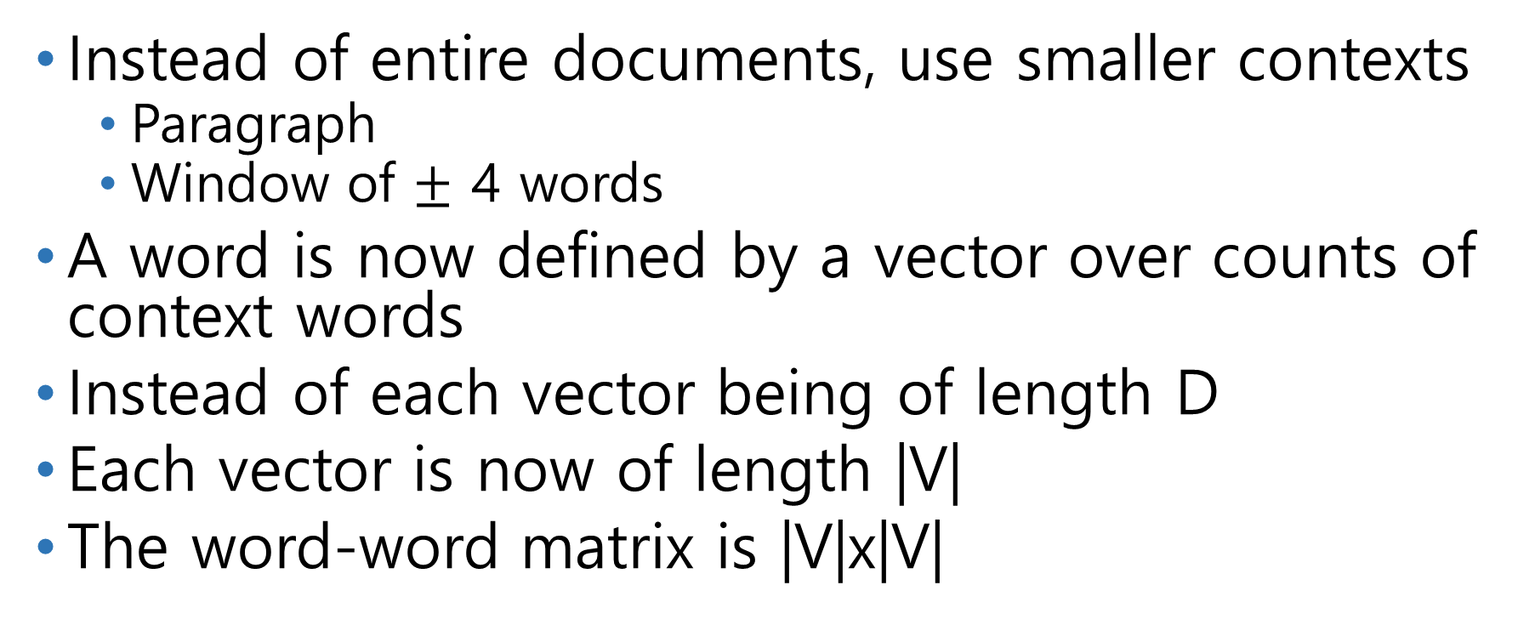
The word-word or word-context matrix
Instead of entire documents, use smaller contexts
Paragraph
Window of $±$ 4 words
A word is now defined by a vector over counts of context words
Instead of each vector being of length D
Each vector is now of length |V|
The word-word matrix is |V|x|V|

Slide 15

Word-Word matrix Sample contexts $±$ 7 words

Slide 16
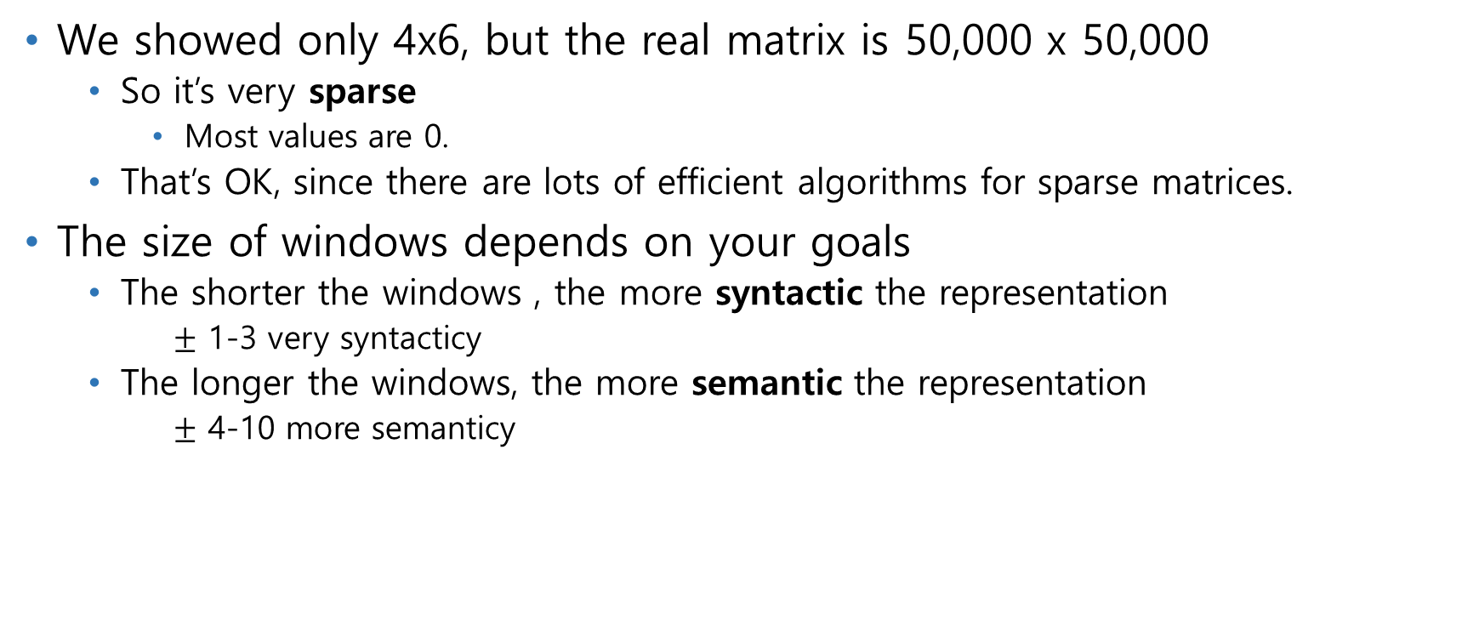
Word-word matrix
We showed only 4x6, but the real matrix is 50,000 x 50,000
So it’s very sparse
Most values are 0.
That’s OK, since there are lots of efficient algorithms for sparse matrices.
The size of windows depends on your goals
The shorter the windows , the more syntactic the representation
$±$ 1-3 very syntacticy
The longer the windows, the more semantic the representation
$±$ 4-10 more semanticy

Slide 17
2 kinds of co-occurrence between 2 words
(Schütze and Pedersen, 1993)
First-order co-occurrence (syntagmatic association):
They are typically nearby each other.
wrote is a first-order associate of book or poem.
Second-order co-occurrence (paradigmatic association):
They have similar neighbors.
wrote is a second-order associate of words like said or remarked.

Slide 18
Vector Semantics
Measuring similarity: the cosine

Slide 19
Measuring similarity
Given 2 target words v and w
We’ll need a way to measure their similarity.
Most measure of vectors similarity are based on the:
Dot product or inner product from linear algebra
High when two vectors have large values in same dimensions.
Low (in fact 0) for orthogonal vectors with zeros in complementary distribution

Slide 20
Problem with dot product
Dot product is larger if the vector is longer. Vector length:
Vectors are longer if they have higher values in each dimension
That means more frequent words will have higher dot products
That’s bad: we don’t want a similarity metric to be sensitive to word frequency

Slide 21
Solution: cosine
Just divide the dot product by the length of the two vectors!
This turns out to be the cosine of the angle between them!

Slide 22
Cosine for computing similarity
Dot product
Unit vectors
v_{i} is the PPMI value for word v in context i
w_{i} is the PPMI value for word w in context i.
Cos(v,w) is the cosine similarity of v and w

Slide 23
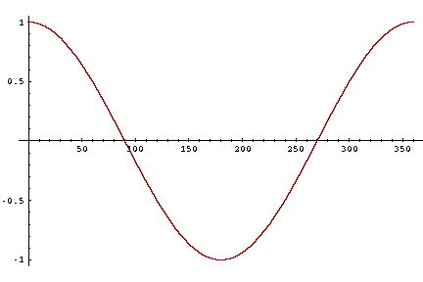
Cosine as a similarity metric
-1: vectors point in opposite directions
+1: vectors point in same directions
0: vectors are orthogonal

Slide 24
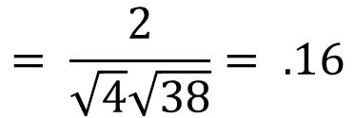
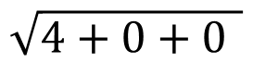
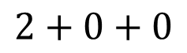
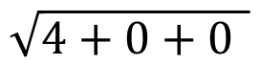
 | large | data | computer
apricot | 2 | 0 | 0
digital | 0 | 1 | 2
information | 1 | 6 | 1
Which pair of words is more similar?
cosine(apricot,information) =
cosine(digital,information) =
cosine(apricot,digital) =
$$2+0+0$$
$$= \frac{2}{\sqrt{4}\sqrt{38}}= .16$$
$$\sqrt{4+0+0 }$$
$$\sqrt{4+0+0 }$$

Slide 25
Visualizing vectors and angles
 | large | data
apricot | 2 | 0
digital | 0 | 1
information | 1 | 6

Slide 26
Clustering vectors to visualize similarity in co-occurrence matrices

Slide 27
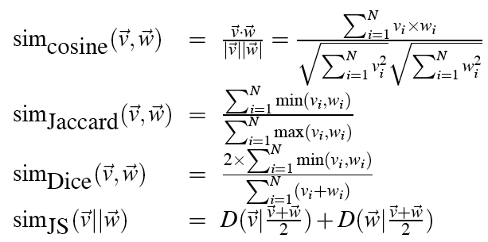
Other possible similarity measures

Slide 28
Vector Semantics
Measuring similarity: the cosine

Slide 29
Using syntax to define a word’s context
Zellig Harris (1968)
“The meaning of entities, and the meaning of grammatical relations among them, is related to the restriction of combinations of these entities relative to other entities”
Two words are similar if they have similar syntactic contexts
Duty and responsibility have similar syntactic distribution:
Modified by adjectives | additional, administrative, assumed, collective, congressional, constitutional …
Objects of verbs | assert, assign, assume, attend to, avoid, become, breach..

Slide 30
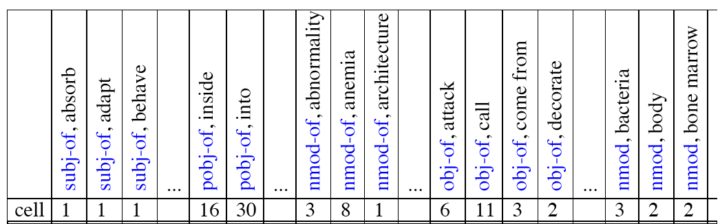
Co-occurrence vectors based on syntactic dependencies
Dekang Lin, 1998 “Automatic Retrieval and Clustering of Similar Words”
Each dimension: a context word in one of R grammatical relations
Subject-of- “absorb”
Instead of a vector of |V| features, a vector of R|V|
Example: counts for the word cell :

Slide 31
Syntactic dependencies for dimensions
Alternative (Padó and Lapata 2007):
Instead of having a |V| x R|V| matrix
Have a |V| x |V| matrix
But the co-occurrence counts aren’t just counts of words in a window
But counts of words that occur in one of R dependencies (subject, object, etc).
So M(“cell”,”absorb”) = count(subj(cell,absorb)) + count(obj(cell,absorb)) + count(pobj(cell,absorb)), etc.

Slide 32
Alternative to PPMI for measuring association
tf-idf (that’s a hyphen not a minus sign)
The combination of two factors
Term frequency (Luhn 1957): frequency of the word (can be logged)
Inverse document frequency (IDF) (Sparck Jones 1972)
N is the total number of documents
df_{i} = “document frequency of word i”
= # of documents with word i
w_{ij} = word i in document j
w_{ij}=tf_{ij} idf_{i}

Slide 33
tf-idf not generally used for word-word similarity
But is by far the most common weighting when we are considering the relationship of words to documents

Slide 34
Vector Semantics
Dense Vectors

Slide 35
Sparse versus dense vectors
PPMI vectors are
long (length |V|= 20,000 to 50,000)
sparse (most elements are zero)
Alternative: learn vectors which are
short (length 200-1000)
dense (most elements are non-zero)

Slide 36
Sparse versus dense vectors
Why dense vectors?
Short vectors may be easier to use as features in machine learning (less weights to tune)
Dense vectors may generalize better than storing explicit counts
They may do better at capturing synonymy:
car and automobile are synonyms; but are represented as distinct dimensions; this fails to capture similarity between a word with car as a neighbor and a word with automobile as a neighbor

Slide 37
Three methods for getting short dense vectors
Singular Value Decomposition (SVD)
A special case of this is called LSA – Latent Semantic Analysis
“Neural Language Model”-inspired predictive models
skip-grams and CBOW
Brown clustering

Slide 38
Vector Semantics
Embeddings inspired by neural language models: skip-grams and CBOW

Slide 39
Prediction-based models: An alternative way to get dense vectors
Skip-gram (Mikolov et al. 2013a) CBOW (Mikolov et al. 2013b)
Learn embeddings as part of the process of word prediction.
Train a neural network to predict neighboring words
Inspired by neural net language models.
In so doing, learn dense embeddings for the words in the training corpus.
Advantages:
Fast, easy to train (much faster than SVD)
Available online in the word2vec package
Including sets of pretrained embeddings!

Slide 40
Skip-grams
Predict each neighboring word
in a context window of 2C words
from the current word.
So for C=2, we are given word w_{t} and predicting these 4 words:

Slide 41
Skip-grams learn 2 embeddings for each w
input embedding v, in the input matrix W
Column i of the input matrix W is the 1×d embedding v_{i} for word i in the vocabulary.
output embedding v′, in output matrix W’
Row i of the output matrix W′ is a d × 1 vector embedding v′_{i} for word i in the vocabulary.

Slide 42
Setup
Walking through corpus pointing at word w(t), whose index in the vocabulary is j, so we’ll call it w_{j} (1 < j < |V |).
Let’s predict w(t+1) , whose index in the vocabulary is k (1 < k < |V |). Hence our task is to compute P(w_{k}|w_{j}).

Slide 43
Intuition: similarity as dot-product between a target vector and context vector

Slide 44
Similarity is computed from dot product
Remember: two vectors are similar if they have a high dot product
Cosine is just a normalized dot product
So:
Similarity(j,k) ∝ c_{k} ∙ v_{j}
We’ll need to normalize to get a probability

Slide 45
Turning dot products into probabilities
Similarity(j,k) = c_{k} ∙ v_{j}
We use softmax to turn into probabilities

Slide 46
Embeddings from W and W’
Since we have two embeddings, v_{j} and c_{j} for each word w_{j}
We can either:
Just use v_{j}
Sum them
Concatenate them to make a double-length embedding

Slide 47
Learning
Start with some initial embeddings (e.g., random)
iteratively make the embeddings for a word
more like the embeddings of its neighbors
less like the embeddings of other words.

Slide 48
Visualizing W and C as a network for doing error backprop

Slide 49
One-hot vectors
A vector of length |V|
1 for the target word and 0 for other words
So if “popsicle” is vocabulary word 5
The one-hot vector is
[0,0,0,0,1,0,0,0,0…….0]

Slide 50
Problem with the softamx
The denominator: have to compute over every word in vocab
Instead: just sample a few of those negative words

Slide 51
Goal in learning
Make the word like the context words
We want this to be high:
And not like k randomly selected “noise words”
We want this to be low:

Slide 52
Skipgram with negative sampling: Loss function

Slide 53
Properties of embeddings
Nearest words to some embeddings (Mikolov et al. 20131)

Slide 54
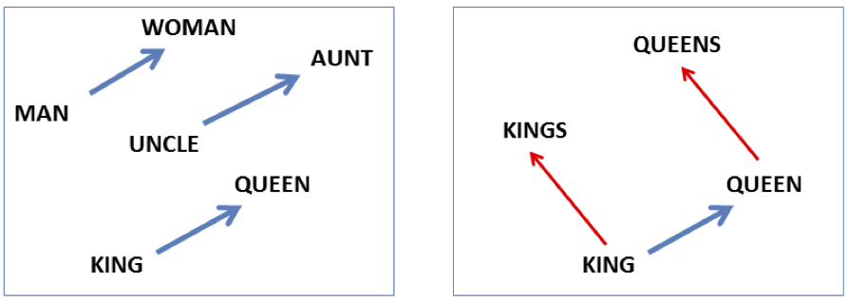
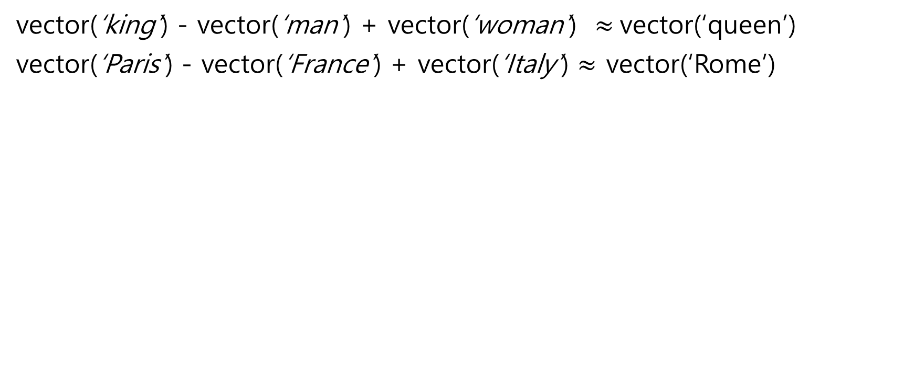
Embeddings capture relational meaning!
vector(‘king’) - vector(‘man’) + vector(‘woman’) $≈$vector(‘queen’)
vector(‘Paris’) - vector(‘France’) + vector(‘Italy’) $≈$ vector(‘Rome’)

